Slide 1
CSE303 Project Presentation
Done by
Faiza Omar Arpita 2010319
Injamam Ul Haque 2021397
Istiaq Ahmed 2021462
Jaima Jahan Khan 2030183
Showrov Mallick 2022185
Syed Niaz Mohtasim 2021607

Slide 2
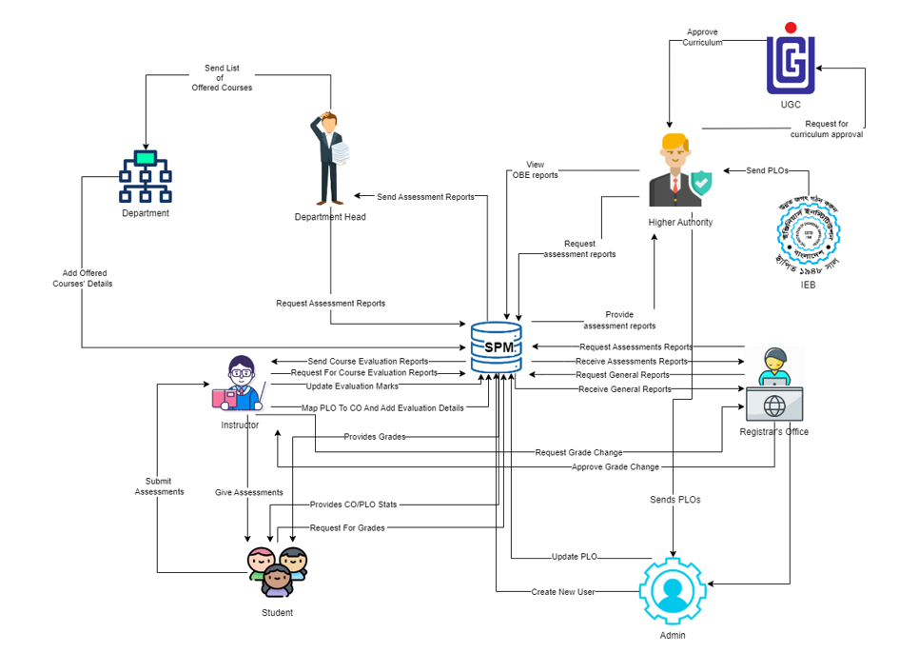
Rich Picture
(AS-IS)

Slide 3
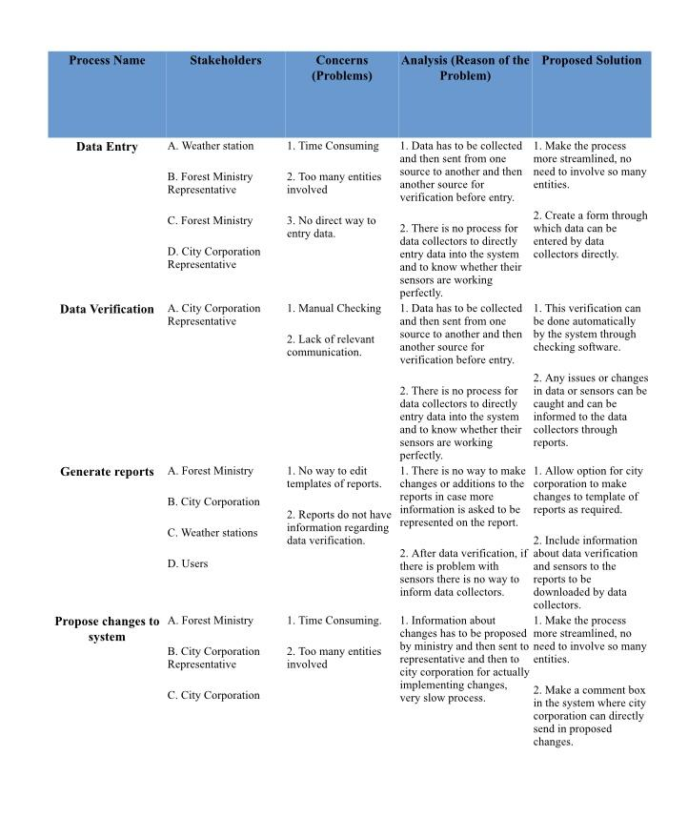
Problem Analysis

Slide 4
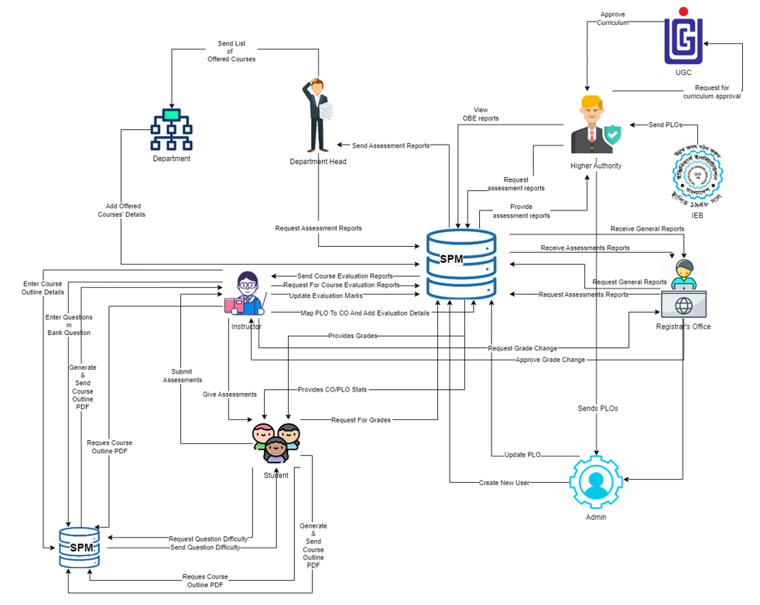
Rich Picture
(TO-BE)

Slide 5
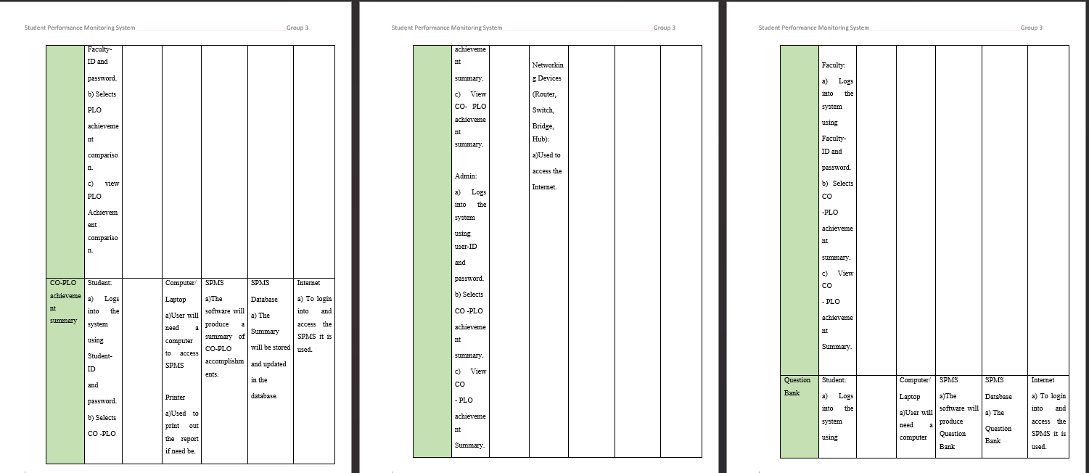
Six Element Analysis - TO BE System

Slide 6
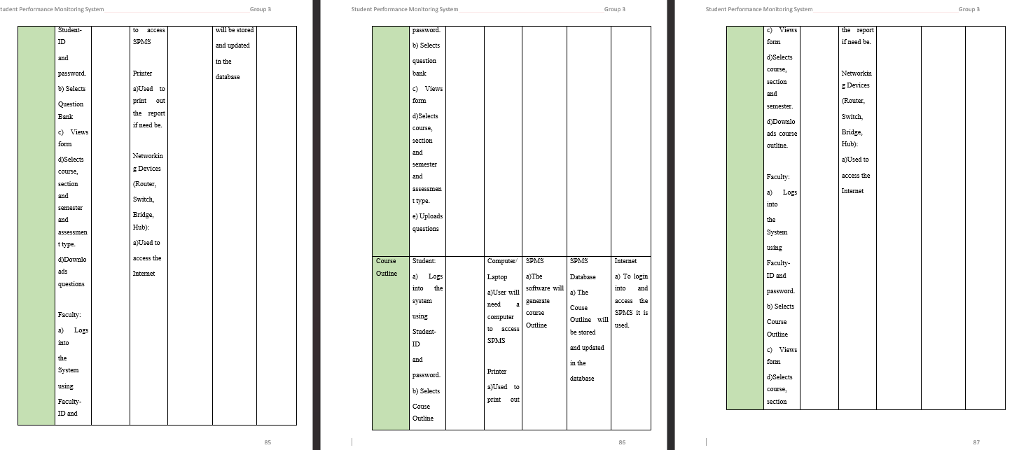
Continued

Slide 7
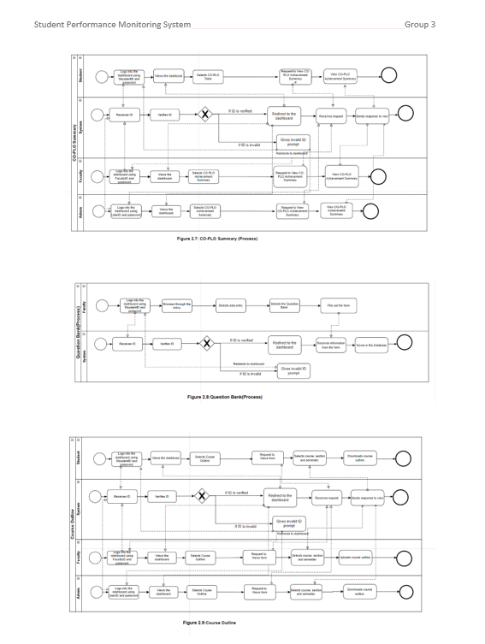
BPMN
(TO BE)

Slide 8
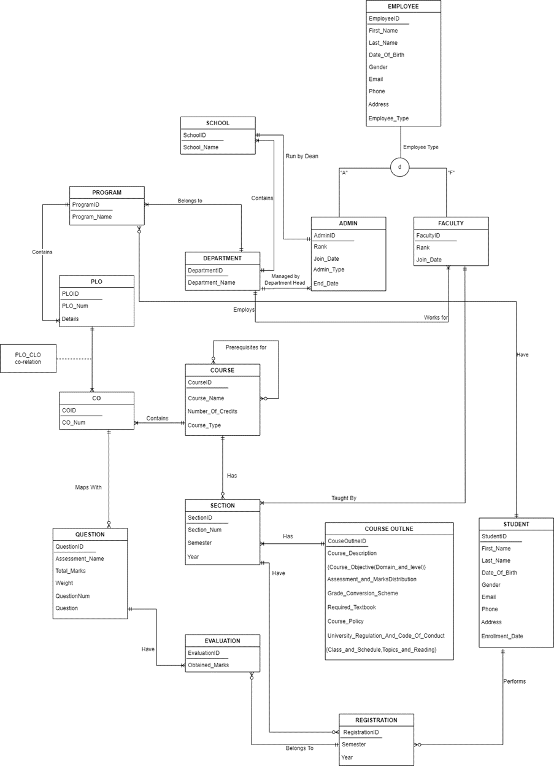
EERD

Slide 9
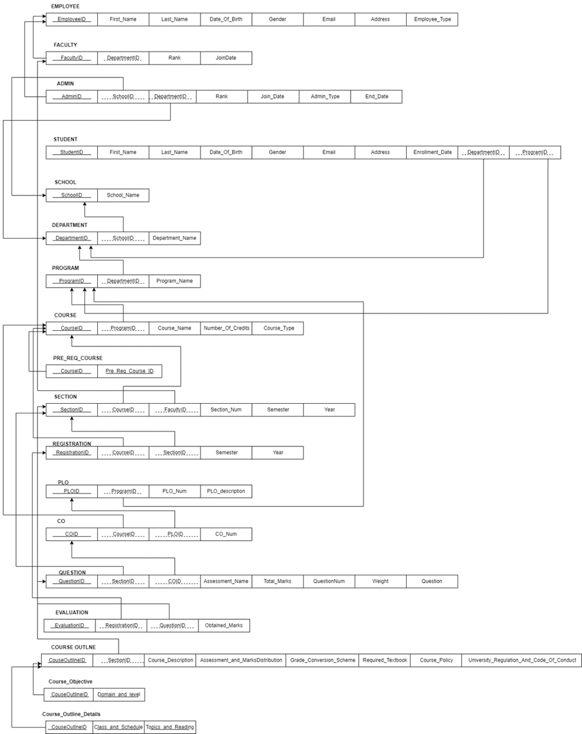
Relational Schema

Slide 10
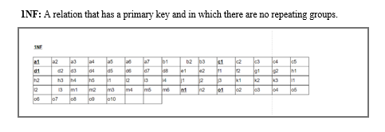
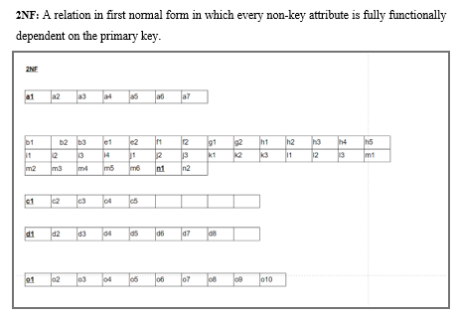
Normalization

Slide 11
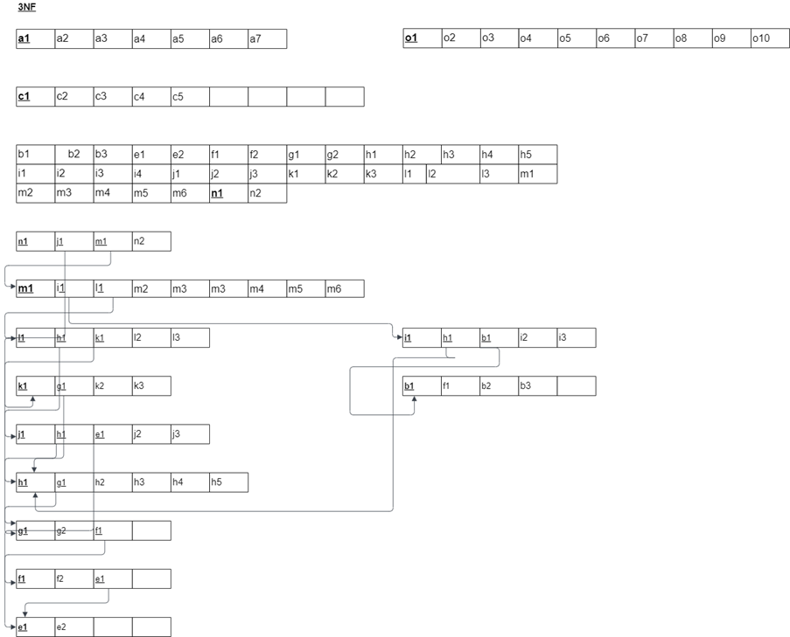
Normalization - Continued
3NF: A relation that is in second normal form and has no transitive dependencies.

Slide 12
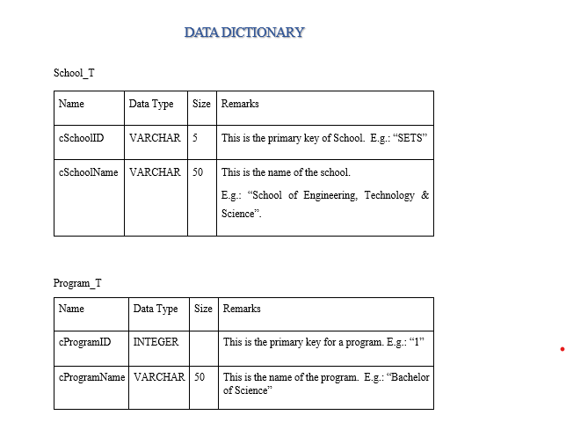

Slide 13
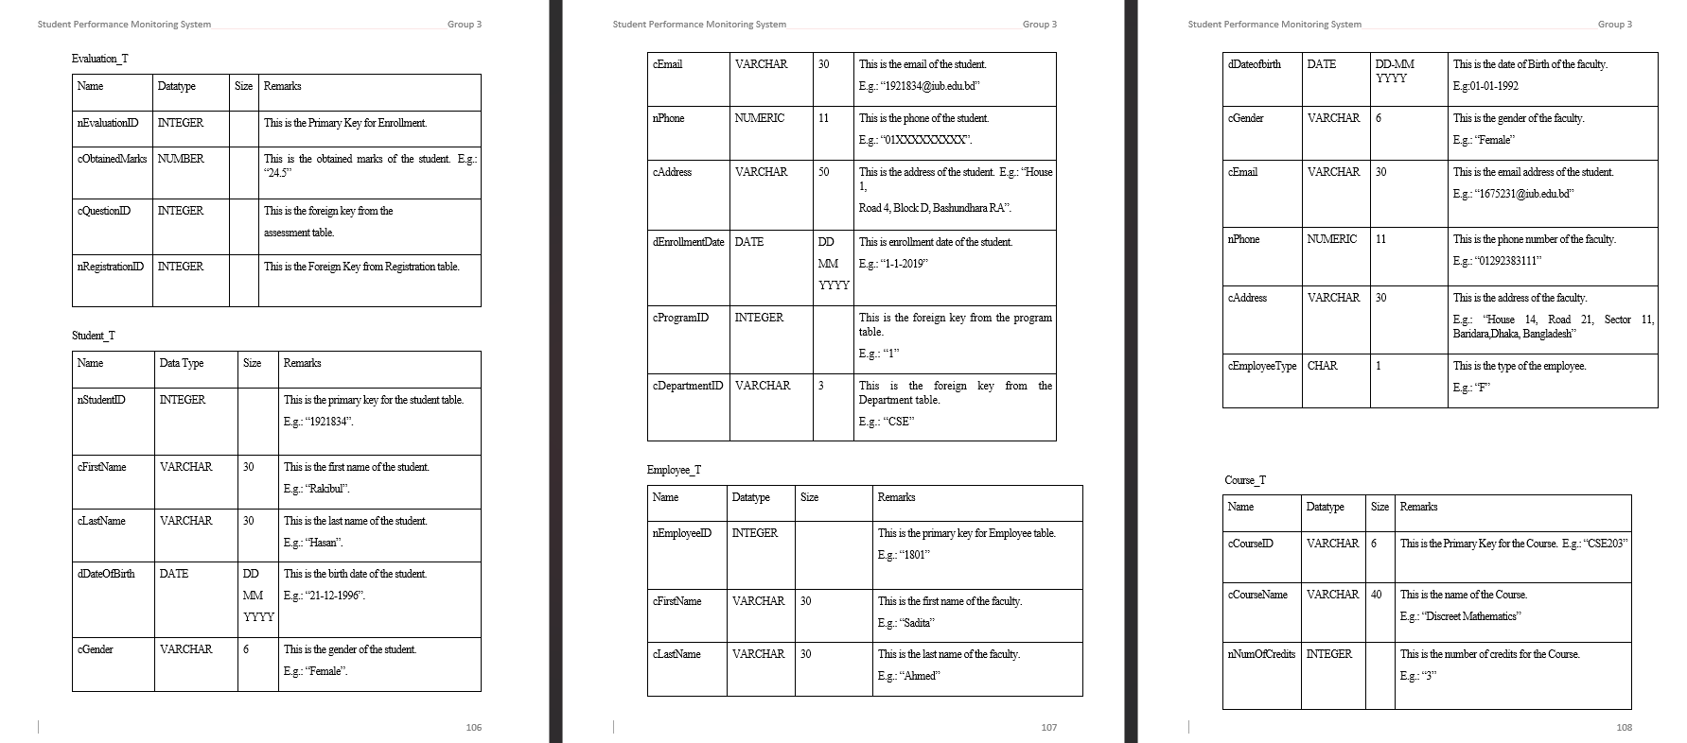

Slide 14
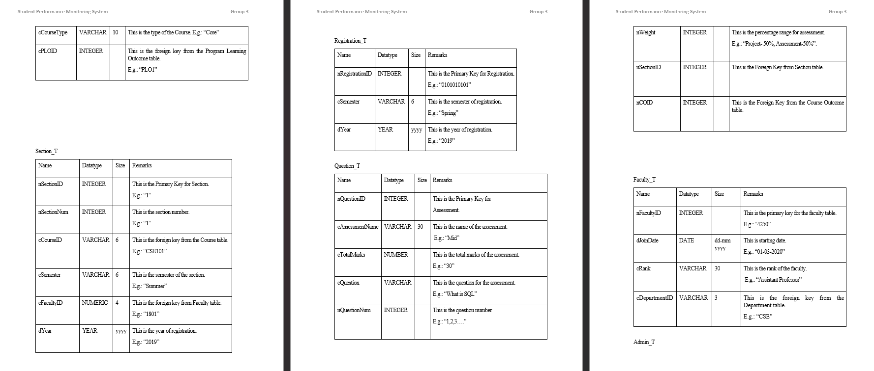

Slide 15
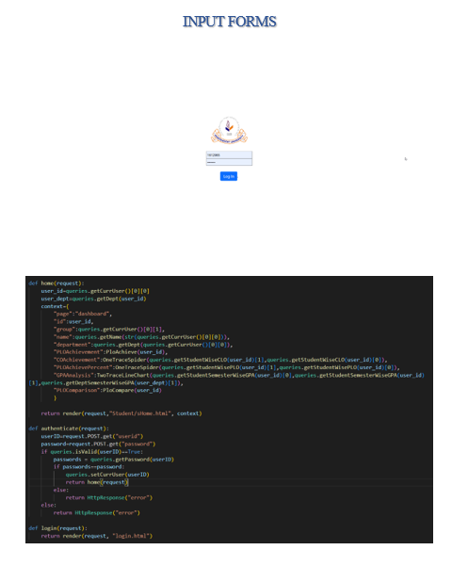
Input Forms

Slide 16
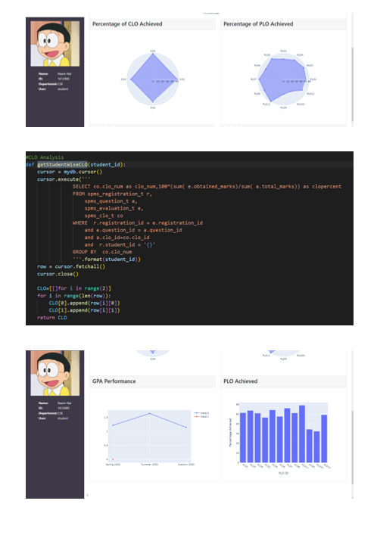
Output Forms

Slide 17
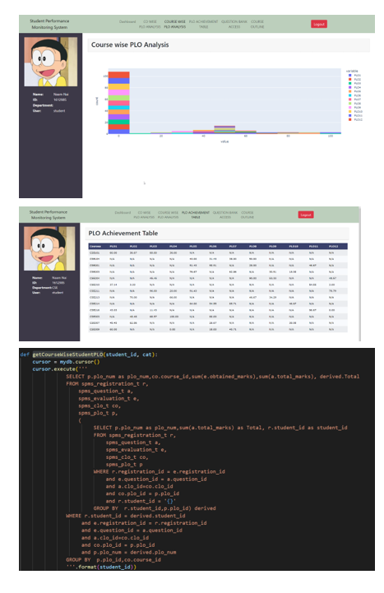
Output Forms

Slide 18
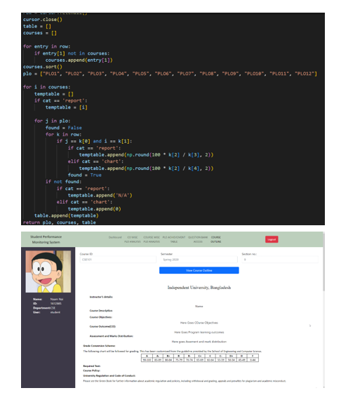
Output Forms

Slide 19
Thank you!

